Slide 1

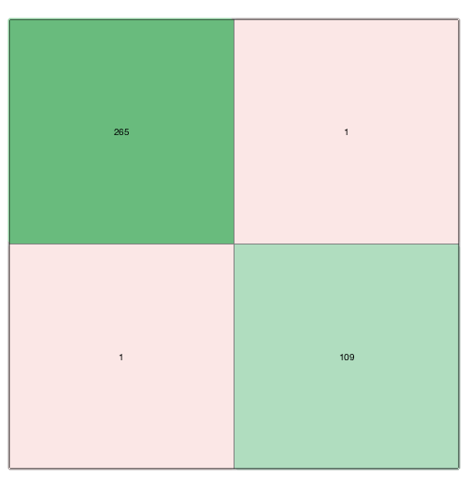
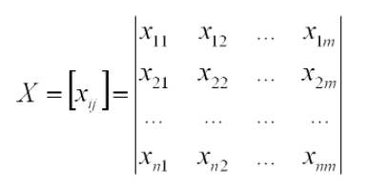
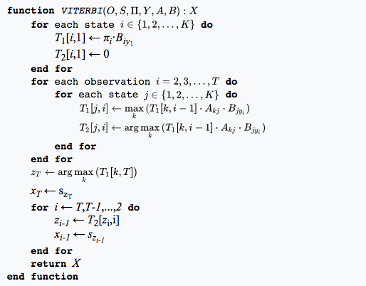
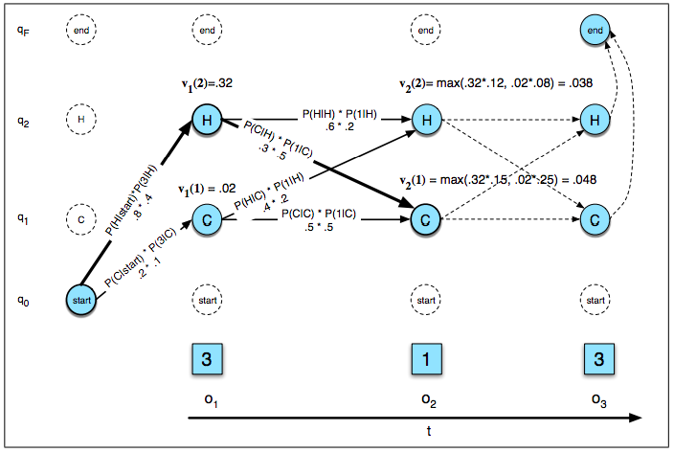
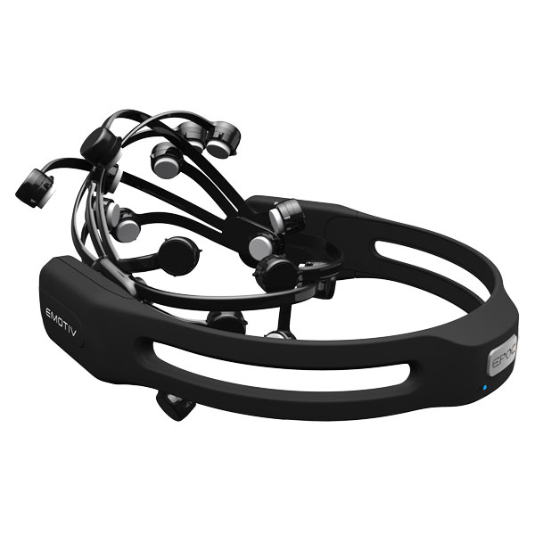
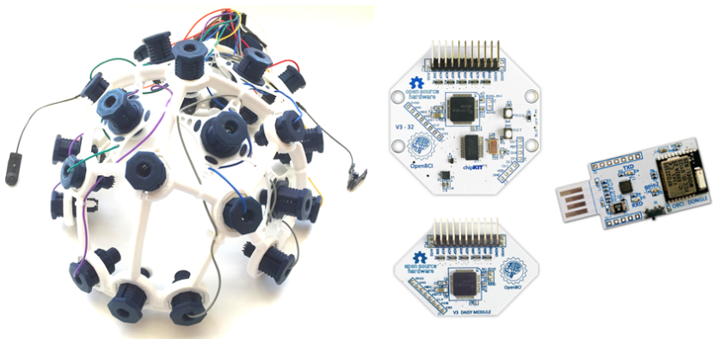

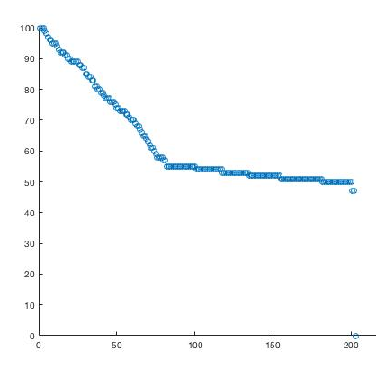
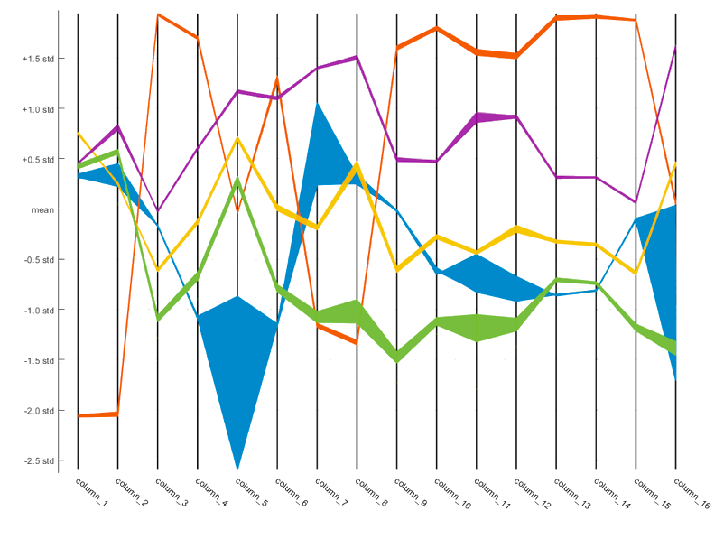
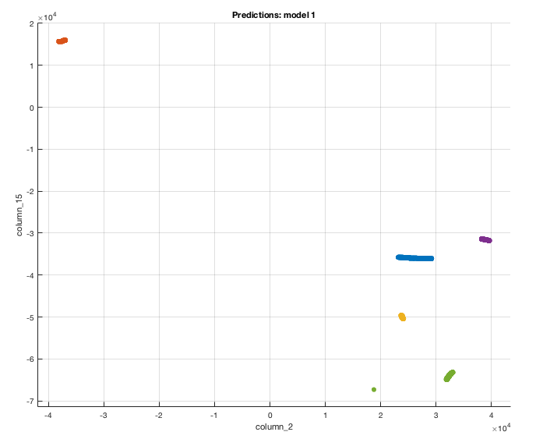
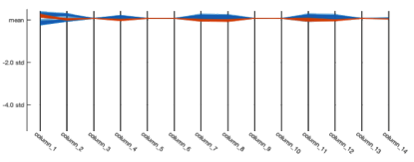
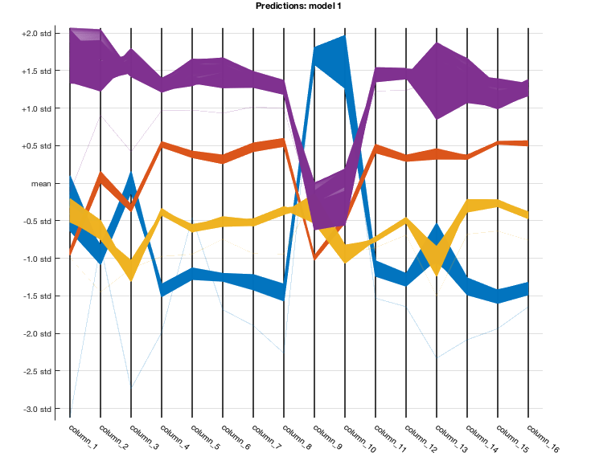

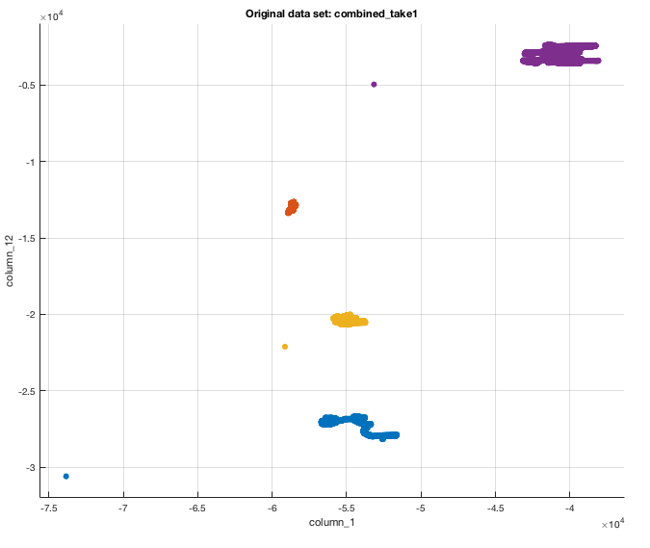
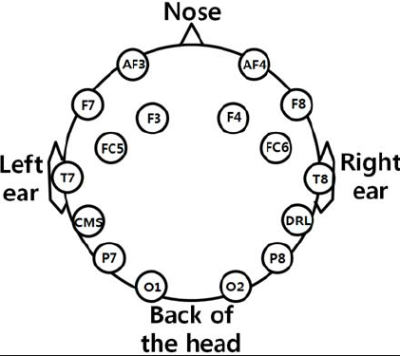
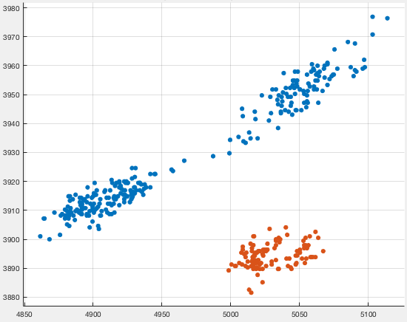
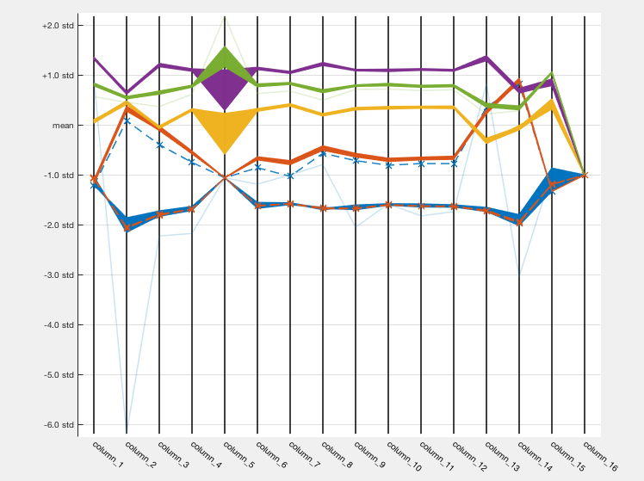
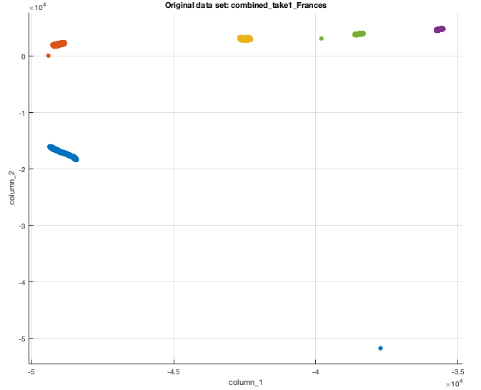
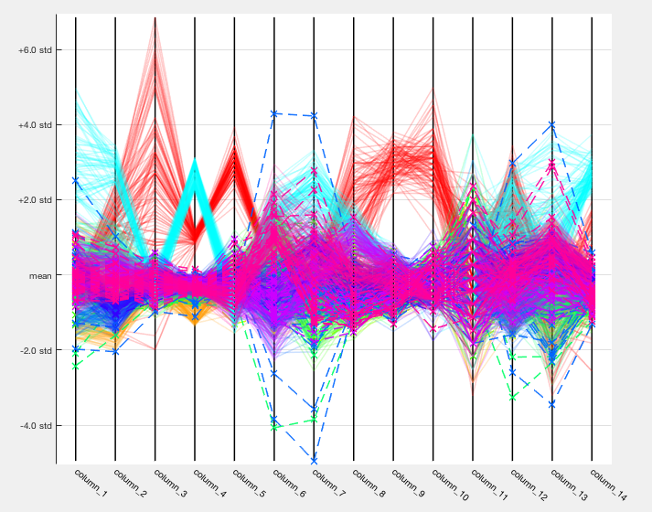
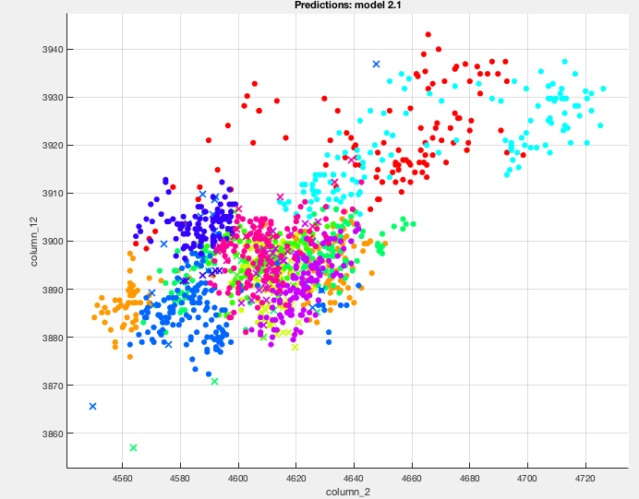

A Novel Approach to Classify and Detect Thoughts using Electroencephalography
Viraat Das
Senior at Morgantown High School, Morgantown WV
1. Introduction
3. Dimensionality Reduction
3. Dimensionality Reduction
4.2 Music (continued)
Electroencephalography (EEG) headsets, being highly portable, present a convenient, noninvasive method of recording the brain’s electrical activity. This project seeks to develop a method for the classification of thoughts, memories, and stimuli from EEG data, for potential use in brain-computer interface (BCI), and the treatment of Aphasia and disabilities that affect verbal communication. The two headsets used were the Emotiv EEG headset and OpenBCI containing 14 electrodes and 16 electrodes, manifesting data as 14 dimensional and 16 dimensional time series. For analysis of multidimensional data machine learning techniques were adopted to train models in the classification The model can classify events given new EEG data, and stochastic neighbor embedding allows visualization of the data in 2-D. Technology enabling nonverbal communication is exciting not only for its futurist appeal, but its potential to help millions suffering from Aphasia and other speech impairments. While methods such as MRI capture data with extreme resolution, EEG headsets would provide a noninvasive, inexpensive and accessible means of translating brain activity. This research aims to contribute to the future development of an EEG based BCI for therapeutic and rehabilitative purposes.
Mapped out the data in a 14 dimensional vector space
Used Principal Component Analysis or T-Distributed Stochastic Neighbor Embedding depending on the complexity of the data
Reducing the dimensions of the data were important to understand what set of algorithms would produce the desired result in the most scalable way
PCA T-SNE
Original matrix
Binary classification for Dog and Tree for a Linear SVM model: 99.5% accuracy rate
Utilized PCA to explain up to 95% of the variance
Model based on the Minkowski (cubic) metric of KNN
KNN:
 | Cubic KNN Model Accuracy | Prediction accuracy with trial 2 | Prediction accuracy with trial 3
Subject 1 | 100% | 96.4% | 95.3%
Subject 2 | 100% | 94.3% | 94.6%
Subject 3 | 99.7% | 94.1% | 93.7%
1. Introduction
Identifies observed clusters
Maps those higher dimensional points to a lower dimension
True
Class
Electroencephalography (EEG) headsets, being highly portable, present a convenient, noninvasive method of recording the brain’s electrical activity. I seek to develop a method for the classification of thoughts, memories, and stimuli from EEG data, for potential use in brain-computer interface (BCI), and the treatment of Aphasia and disabilities that affect verbal communication. The two headsets used were the Emotiv EEG headset and OpenBCI containing 14 electrodes and 16 electrodes respectively, manifesting data as 14-D and 16-D time series. For analysis of multidimensional data, I adopted support vector machines (SVM) and K-Nearest Neighbor learning algorithms to train models in the classification The model can classify events given new EEG data, and stochastic neighbor embedding allows visualization of the data in 2-D. Technology enabling nonverbal communication is exciting not only for its futurist appeal, but its potential to help millions suffering from Aphasia and other speech impairments. While methods such as MRI capture data with extreme resolution, EEG headsets would provide a noninvasive, inexpensive and accessible means of translating brain activity. This research aims to contribute to the future development of an EEG based BCI for therapeutic and rehabilitative purposes.
Hidden Markov Model
2) Calculated the covariance matrix using
a scaling factor of
3) The variance at most would be 95% to
ensure scalability of data while still
being able to explain the features
Using model to predict the result of the second take of data: 96.1%
Predicted Class
Emotiv Headset
PCA returns a linear transformation for dimensionality reduction from the original matrix. T-SNE is non-linear and can capture trickier manifestations of the data, however it requires more computing power than PCA.
4.2 Music (Auditory)
OpenBCI
Five songs were analyzed
Overture by Pyotr Ilyich Tchaikovsky (0)
Asturias by Isaac Albeniz (1)
Op Op by Unknown (2)
The Sorceress Apprentice by Paul Dukas (3)
Suite española by Isaac Albeniz (4)
2. Research Goals
Accuracy of the Model with Markov Models
The research consisted of three basic goals
If “thoughts” in the form of EEG Data can, in fact, be classified
A systematic way to predict the classification of new thoughts based on old data for a particular individual
Make sure the results were scalable with a high data and feature count size
Create a model that scales with each individuals data
4.1 Dogs and Trees
This confirmed that thoughts could indeed be classified and a thought prediction model could be created.
Accuracy
Emotiv Headset
OpenBCI
2. Research Goals
3. Implementation
The research consisted of three basic goals
If “thoughts” in the form of EEG Data can in fact be classified
A systematic way to predict the classification of new thoughts based on old data
Make sure the results were scalable with a high data and feature count size.
Figuring out the best set of algorithms to implement required having a visual sense of the data. Every electrode mapped out its own time series.
Vitebri Sets
Parallel Coordinate Plot – shows the variance in each electrode
Dogs
Trees
Subject 1
EEG data grouping from AF3 and F7 sensors
General electrode configuration of an EEG headset
- dog
3. Implementation
- tree
The clustering of the data shows that a
Linear SVM will work well
Figuring out the best set of algorithms to implement required having a visual sense of the data. Every electrode mapped out its own set of voltages.
Subject 2
Visualizing 14-D and 16-D data required
General electrode configuration of an EEG headset
Subject 3
Visualizing 14-D and 16-D data required
4.3 Pizza Toppings (Visual)
Collected data while subject viewed these toppings on the following pizza:
Anchovies (0)
Bacon (1)
Canadian Bacon (2)
Grilled Chicken (3)
Ground Beef (4)
Ham (5)
Italian Sausage (6)
Pepperoni (7)
Prosciutto (8)
Spicy Italian Sausage (9)
Ham (5)
Italian Sausage (6)
Pepperoni (7)
Prosciutto (8)
Spicy Italian sausage (9)
Both PCA and T-SNE would be valid. Due to low cost, PCA was chosen with an explained variance of 95%
Quadratic SVM returned an accuracy rate of 94.1%
Model tested with second take showed an accuracy rate of 89.2%
5. Future Works and Conclusion
Depending on data criteria, these models can be tuned for an individual
and used for thought classification in that context
Possible usage: communicative device for patients suffering from Broca’s
Aphasia, BCI, neuroscience research, and much more
Inexpensive EEG data is indeed scalable and with proper techniques can
be utilized to create a accurate model.

